Slide 1
Working with JPG image files
An extension for Mission 8

Slide 2
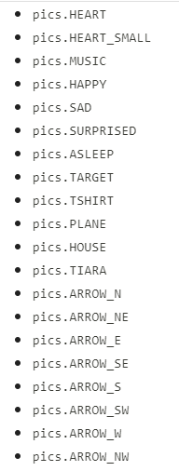
Displaying images on Codex
The CodeX comes with many images that are available through the codex module. They are bitmap images.
You might want to use your own images, which are often JPG files.

Slide 3
Adding JPG image files
You can add images that are JPG files to your CodeX. Just follow these steps.
Find an image, or use one of your own images.
  You should be aware of copyright laws. If you look on the internet for images, look for creative commons or royalty free images.
  You should always give credit for the image in a comment in your code.

Slide 4

Making the JPG image useable
Before you can upload and use the image, it needs to be the correct size and compression.
2. Use Photopea
  Click on the link for Photopea, an online photo editor.
3. Open your image.
  This is easiest if it is saved to your computer or a flash drive or Google drive for easy access.

Slide 5
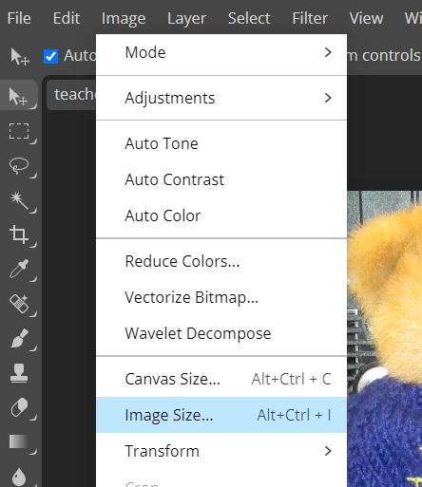
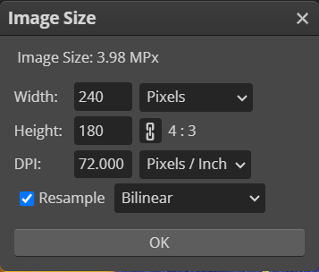
Making the JPG image useable
4. Change the image size to 240x240 pixels (or smaller)
Click on Image – Image Size
Change Width & Height
Change the DPI to 72
The RESAMPLE needs to be
Bilinear
Max: 240 pixels
DPI
Resample

Slide 6
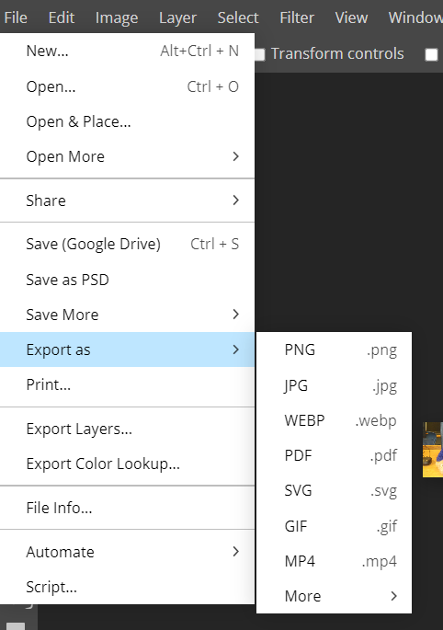
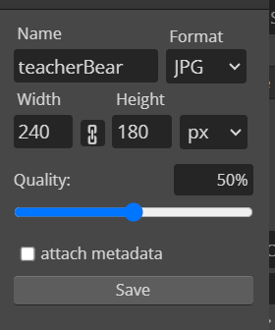
Making the JPG image useable
5. Export the image as a JPG
Click on File – Export as
Choose JPG
Give the image a simple name
(no spaces)
Save it where
you can find it

Slide 7
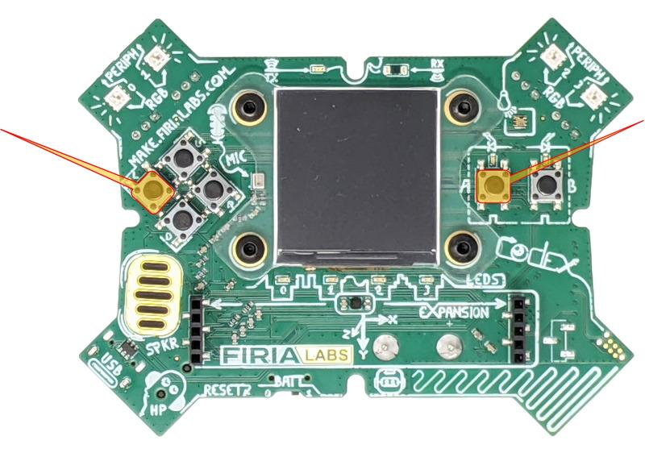
Adding JPG image files
6. Put your CodeX into USB-writeable mode (youtube video demonstration)
  Make sure the CodeX is
  connected to your
  computer
  Press and hold the
  L and A buttons
  and keep holding
  them down

Slide 8
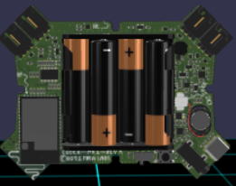
Adding JPG image files
6. Put your CodeX into USB-writeable mode
c. Reach around and
briefly press the
RESET button
(press and release)

Slide 9
Adding JPG image files
6. Put your CodeX into USB-writeable mode
d. Keep holding buttons A and L until you see the red LEDs light up from 3 to 0 in right-to-left order.
e. You will see a double-flash of ALL red LEDs to confirm the filesystem is in USB-writable mode.

Slide 10
Adding JPG image files
6. Put your CodeX into USB-writeable mode
f. Now release L and A.
g. You are ready to upload your files to the Codex
For more information, check out the documentation: https://docs.firialabs.com/codex/WorkingWithFiles.html

Slide 11
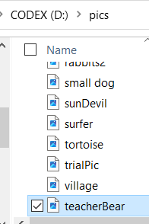
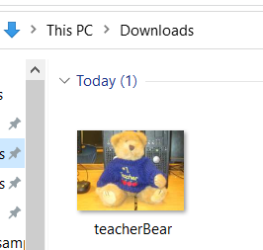
Adding JPG image files
7. Upload your image files to the CodeX
  You can upload write to the CodeX, or you can create a folder for pics and upload there

Slide 12
Adding JPG image files
8. Make the CodeX unwritable again by disconnecting it from the computer and then connecting again.

Slide 13

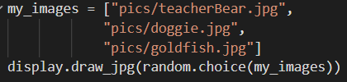
Adding JPG image files
9. Use the display.draw_jpg command to display the JPG image.
or
image file (use the path name if in a folder), put the name here, in “_”
Use a variable that is assigned the image file name
Or use a list and choose a random item from the list

